Slide 1
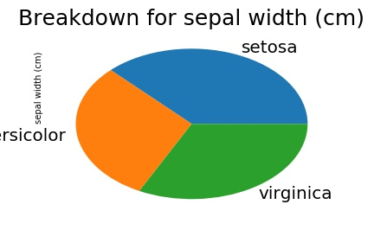
The main purpose of pie charts are to easily and visually show the size difference between certain elements being measured. They are easily read and understood by humans.
The most important part is to use these charts to only convey information of the elements relative to each other.

